Slide 1

Chapter 5

Slide 2
PV Cells
Single PV cell: around 0.6 V; efficiency vary from 3 to 31%, depending on technology, light spectrum, temperature, design, and material.
Semiconductor characteristics define the electrical energy conversion efficiency of solar cells. Typical efficiency is at 10 ~15%. At noon on a clear day, a PV cell can generate average of 100 watts/m^2.
Common materials: Monocrystalline silicon, Polycrystalline silicon. Amorphous silicon, Gallium arsenide, Copper indium-selenide,Cadmium telluride (CdTe).

Slide 3
The Best laboratory PV cell efficiencies for various technologies.

Slide 4
PV module manufacturing costs for DOE/US Industry Partners

Slide 5
World production of photovoltaic

Slide 6
The Distribution of the Protons and Electrons in the silicon atom
(a) Tetrahedral
Two-dimensional version

Slide 7
Quantum Physics
Who first developed Quantum theory to explain photovoltaic effect?
Quantum mechanics is the study of the relationship between energy quanta (radiation) and matter, in particular that between valence shell electrons and photons. (quantization of energy)
Light is composed of photons. The energy of every photon is:
E = h f
h: Planck’s constant; f: frequency of light for each photon.
Photoelectric effect: when light falls upon certain metals, electrons are ejected from the metals. Only high frequency photons have the concentrated energy needed to pull loose an electron in the valence shell.

Slide 8
Quantum Physics
Niels Bohr’s Planetary model of the atom: an electron is in different energy levels when it is in different orbits. The electrons in an atom normally occupy the lowest energy levels available.
Bohr calculated the ionization energy: the energy needed to knock the electron out of the atom completely.
Changes in electron energies produce visible light. Larger changes produce X-rays (electrons transition from outer orbits to innermost orbits).

Slide 9
Photons
Photons are characterized by their wavelength (frequency) and their energy
(8.2) (v is frequency here)

Slide 10
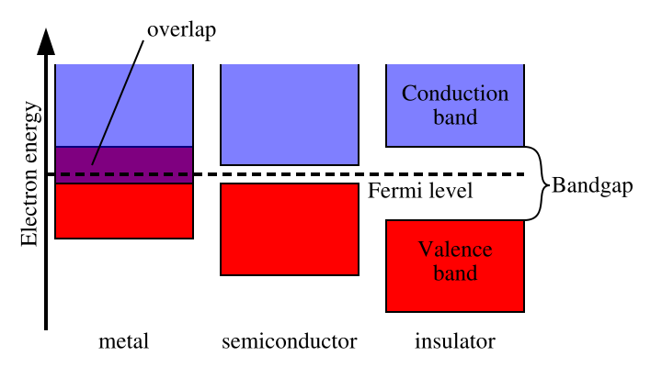
"band gap" refers to the energy difference between the top of the valence band and the bottom of the conduction band, where electrons are able to jump from one band to another.

Slide 11
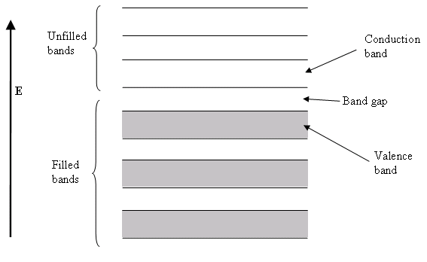
Semiconductor band structure
In semiconductors and insulators, the conduction band is the range of electron energy, higher than that of the valence band, sufficient to make the electrons free to accelerate under the influence of an applied electric field and thus constitute an electric current. Semiconductors may cross this conduction band when they are excited

Slide 12
The electrons occupy the valence band and can be excited into the conduction band by thermal energy (thermal electric technology) or by absorption of photons (Photovoltaic technology) with energy quantum higher than the energy gap. The bandwidth of the energy gap is characteristic for each semiconductor.

Slide 13
Band gap engineering
Band gap engineering is the process of controlling or altering the band gap of a material by controlling the composition of certain semiconductor alloys, such as GaAlAs, InGaAs, and InAlAs. It is also possible to construct layered materials with alternating compositions by techniques like molecular beam epitaxy. These methods are exploited in the design of heterojunction bipolar transistors (HBTs), laser diodes and solar cells.

Slide 14
Band–gap energy
That energy which an electron must acquire in order to free itself from the electrostatic binding force that ties it to its own nucleus so it is free to move into the conduction band and be acted on by the PV cell’s induced E-field structure.
When an electron passes from one band to other, it leaves in its place a hole that can be considered a positive charge → electron-hole pair.

Slide 15
Band gap energy unit
eV: the units for band-gap energy are usua. Electron-volts (eV), which is the energy that an electron acquires when its voltage is increased by 1 V (1 eV=1.6

Slide 16
Material | Symbol | Band gap (eV) @ 300K
Silicon | Si | 1.11 ^{[1]}
Germanium | Ge | 0.67 ^{[1]}
Silicon carbide | SiC | 2.86 ^{[1]}
Aluminum phosphide | AlP | 2.45 ^{[1]}
Aluminum arsenide | AlAs | 2.16 ^{[1]}
Gallium(III) nitride | GaN | 3.4 ^{[1]}
Gallium(II) sulphide | GaS | 2.5 (@ 295 K)
Gallium antimonide | GaSb | 0.7 ^{[1]}
Indium(III) phosphide | InP | 1.35 ^{[1]}
Indium(III) arsenide | InAs | 0.36 ^{[1]}
Cadmium sulfide | CdS | 2.42 ^{[1]}
Cadmium selenide | CdSe | 1.73 ^{[1]}
Cadmium telluride | CdTe | 1.58 ^{[1]}

Slide 17
Band Gap (eV) and cutoff Wavelength
PV Materials Band Gap Wavelength
Silicon 1.12 eV 1.11 μm
Ga-As 1.42 eV 0.87 m
Cd-Te 1.5 eV 0.83 m
In-P 1.35 eV 0.92 m

Slide 18
Silicon Solar Cell Max Efficiency
Upper bound on the efficiency of a silicon solar cell:
Band gap: 1.12 eV, Wavelength: 1.11 μm
This means that photons with wavelengths longer than 1.11 μm cannot send an electron to the conduction band.
Photons with a shorter wavelength but more energy than 1.12 eV dissipate the extra energy as heat.

Slide 19
Photon Energy

Slide 20
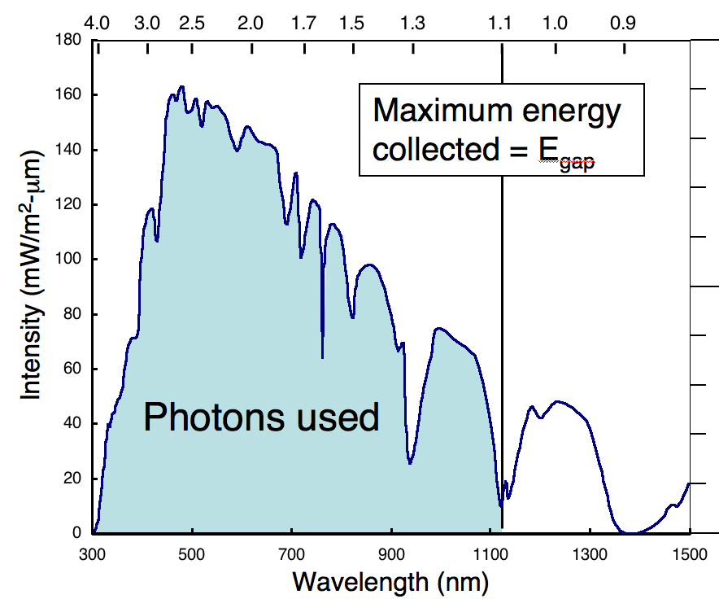
Silicon Solar Cell Max Efficiency
For an Air Mass Ratio of 1.5 (42deg altitude angle of Sun), 49.6% is the maximum possible fraction of the sun’s energy that can be collected with a silicon solar cell
(need better pic text fig. 8.10)

Slide 21
PV Efficiency
SILICON
Photons with more than enough energy
Photons with not enough energy
Photons energy hv
E (ev)
Lost energy hv>E_{g}
Usable energy
Lost energy hv<E_{g}
E_{g}=1.12
Wavelength(μm)
1.11
E = hc / λ
c = 3X10⁸m/s
h is Planck’s constant:6.626X10⁻³⁴J-S
E is the photon energy (J)
1eV = 1.6 X 10 ⁻¹⁹ J
λ is the photo wavelength

Slide 22

Limitations to Solar Cell Performance
Analysis for a 24%-efficient Si solar cell
Energy (eV)
All photon energy above V_{oc} is lost.
Unused Photons 19%
Maximum energy collected = E_{gap}
31% Loss for Energy above E_{gap}
Intensity (mW/m²-μm)
Radiate+hole-saturate16%
Other losses:
Absorption
Collection
Reflection
Series R
Shunts
Fill Factor 5%
Photons used
Other Losses 5%
Usable power 24%

Slide 23
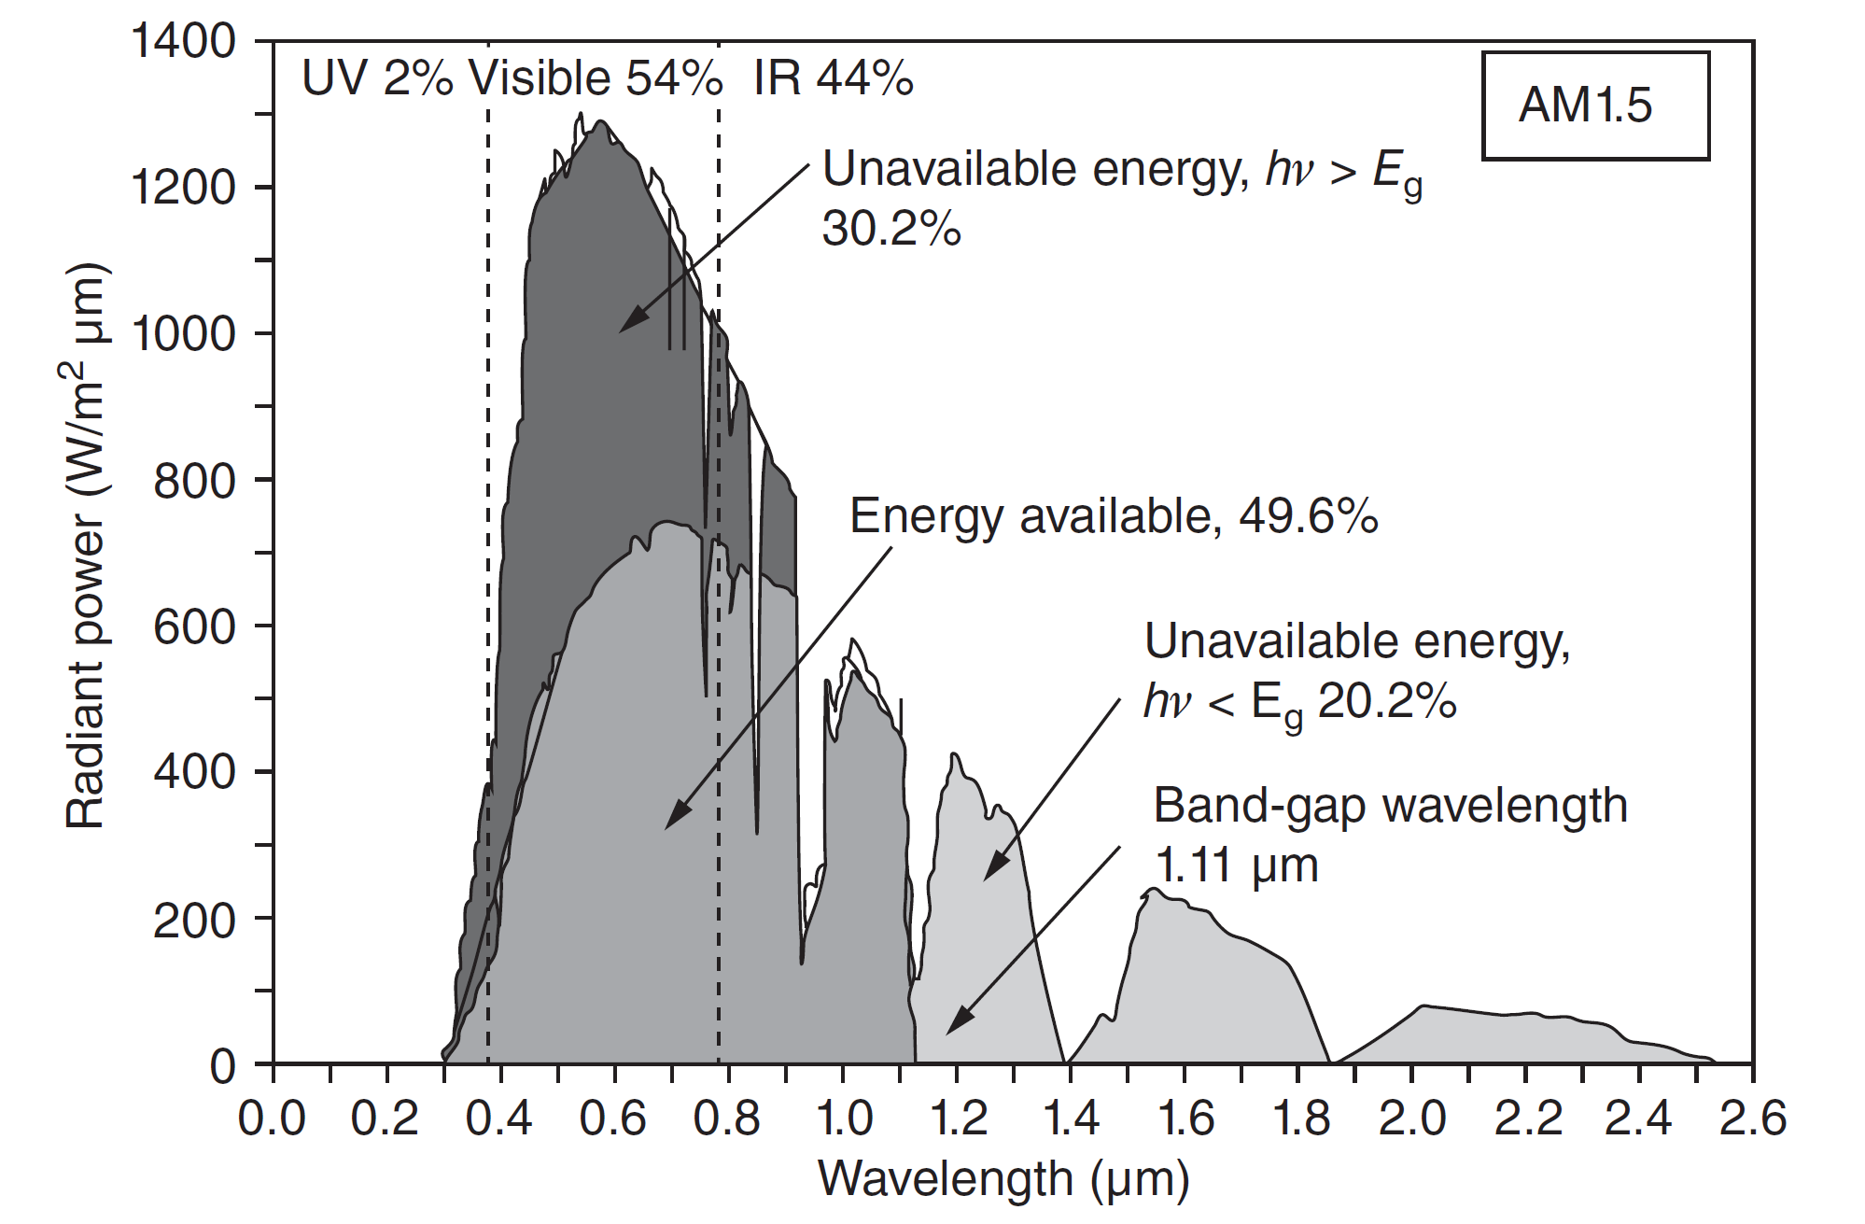
Limitations to Solar Cell Performance

Slide 24
Summary
When a photon is absorbed, its energy is given to an electron in the crystal lattice.
A photon needs only have greater energy than that of the band gap in order to excite an electron from the valence band into the conduction band. However, the solar frequency spectrum approximates a black body spectrum at ~6000 K, and as such, much of the solar radiation reaching the Earth is composed of photons with energies greater than the band gap of silicon. These higher energy photons will be absorbed by the solar cell, but the difference in energy between these photons and the silicon band gap is converted into heat (via lattice vibrations — called phonons) rather than into usable electrical energy ➔ limitation for PV efficiency.

Slide 25
Photons have more than enough or not enough energy
Sources of PV cell losses
  Photons with long wavelengths but not enough energy to excite electrons across band-gap (20.2% of incoming light)
  Photons with shorter wavelengths and plenty (excess) of energy to excite an electron (30.2% is wasted because of excess
  So, Silicon based PV technology max(η)=49.6% (maximum possible efficiency, not considering internal resistance, recombination of holes and electrons, reflection, etc)
  Electron-hole recombination within cell (15-26%)
Typical PV cell efficiency today: η=15-24%

Slide 26
Energy Loss in a Solar Cell
Light can be separated into different wavelengths. Since the light that hits our cell has photons of a wide range of energies, it turns out that some of them won't have enough energy to form an electron-hole pair. They'll simply pass through the cell as if it were transparent. Still other photons have too much energy. Only a certain amount of energy, measured in electron volts (eV) and defined by our cell material (about 1.12 eV for crystalline silicon), is required to knock an electron loose. We call this the band gap energy of a material. If a photon has more energy than the required amount, then the extra energy is lost (unless a photon has twice the required energy, and can create more than one electron-hole pair, but this effect is not significant). These two effects alone account for the loss of around 70 percent of the radiation energy incident on our cell.

Slide 27
Energy Loss in a Solar Cell
Why can't we choose a material with a really low band gap, so we can use more of the photons? Unfortunately, our band gap also determines the strength (voltage) of our electric field, and if it's too low, then what we make up in extra current (by absorbing more photons), we lose by having a small voltage. Remember that power is voltage times current. The optimal band gap, balancing these two effects, is around 1.4 eV for a cell made from a single material.

Slide 28
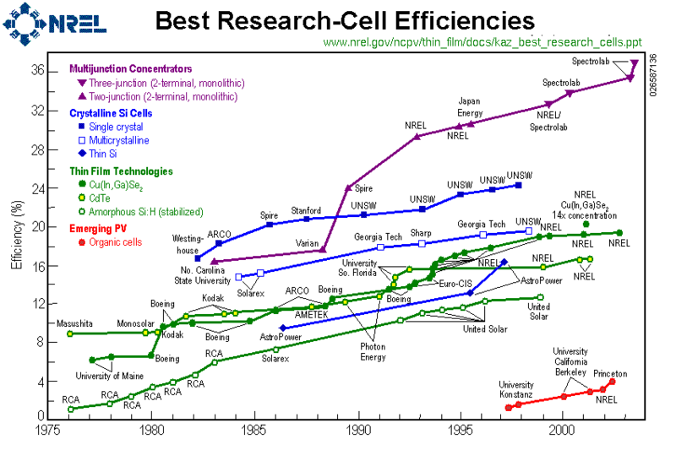
Reported timeline of solar cell energy conversion efficiencies (from NREL)

Slide 29
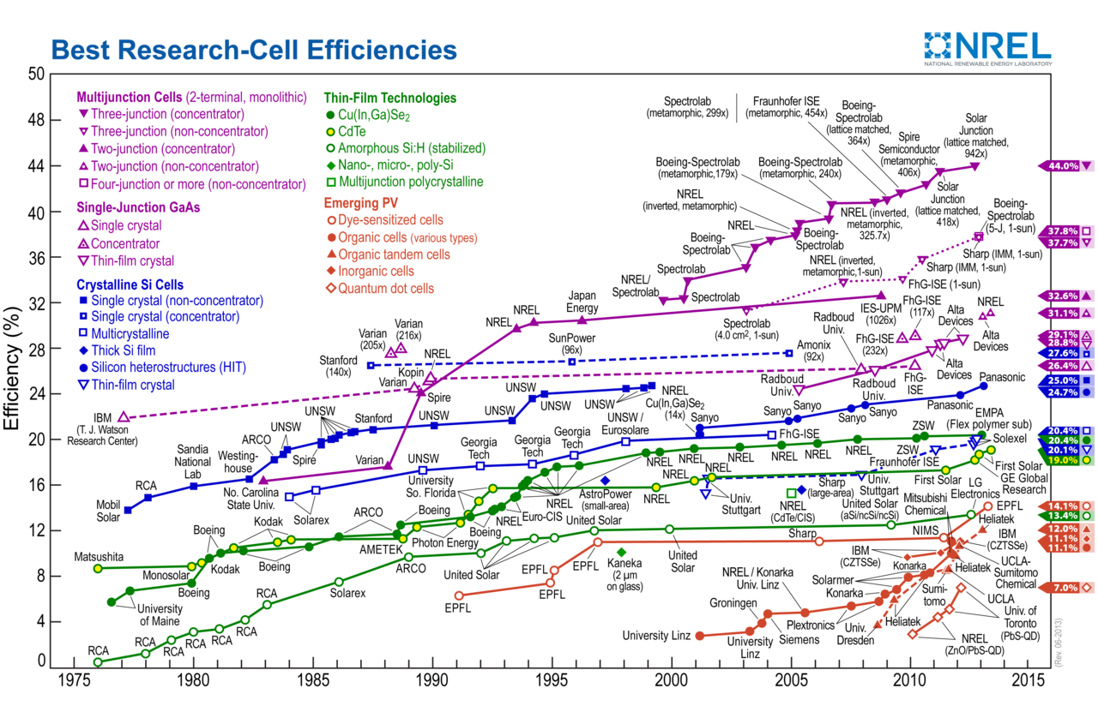
Reported timeline of solar cell energy conversion efficiencies (from NREL)

Slide 30
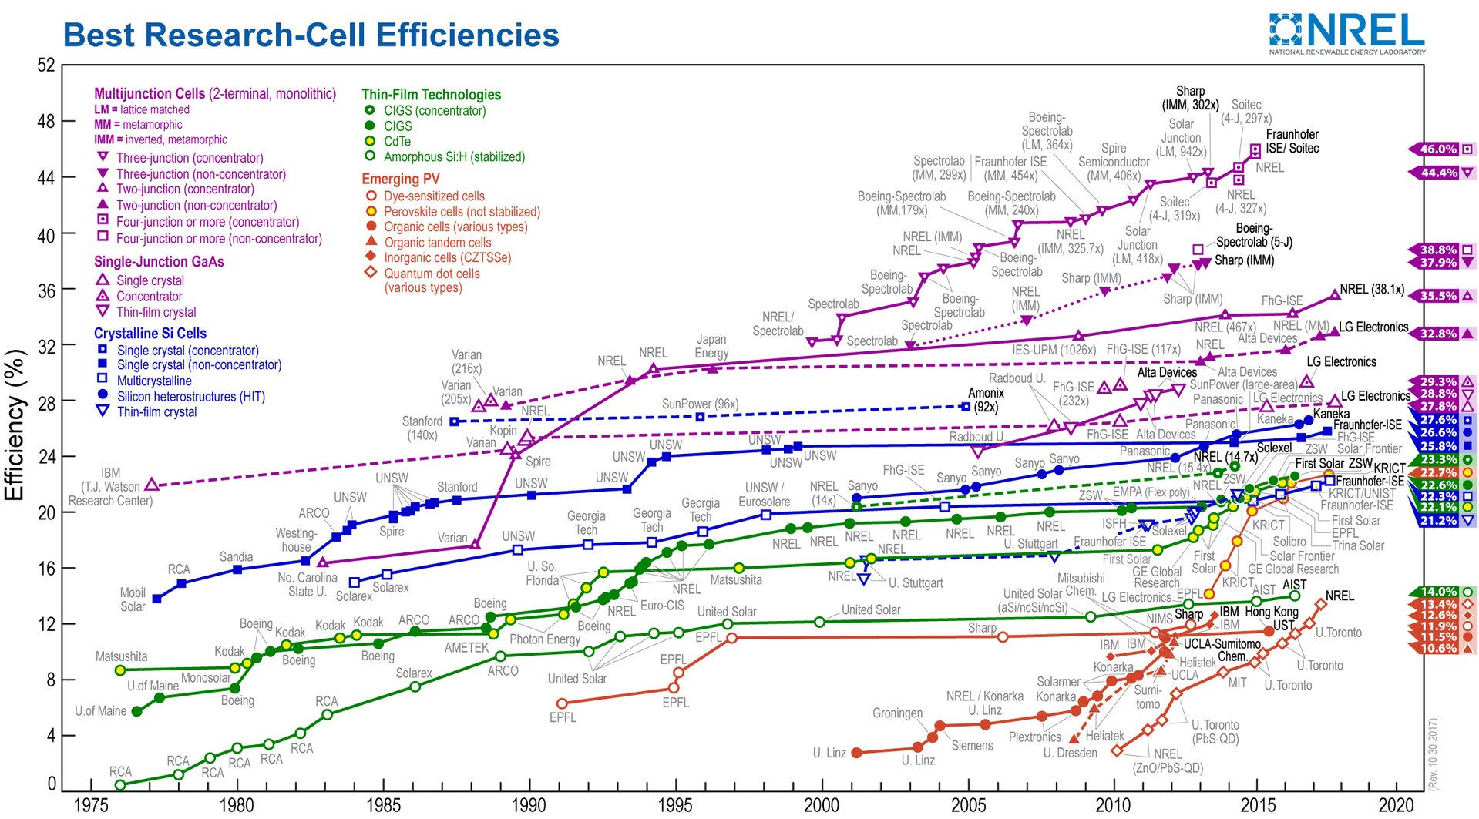
Reported timeline of solar cell energy conversion efficiencies (from NREL)

Slide 31
PV technology efficiencies
1970s/1980s → 2003 (best lab efficiencies)
3 → 13% amorphous silicon
6 → 18% Cu In Di-Selenide
14 → 20% multi-crystalline Si
15 → 24% single crystal Si
16 → 37% multi-junction concentrators

Slide 32
Example
What afftects maximum potential efficiency of a silicon based PV cell?
What are the three major sources of the losses?

Slide 33
Example
What affects maximum potential efficiency of a silicon based PV cell?
Clue: solar photon spectrum; band gap energy 1.12eV; too long wavelength photons cannot be useful; the short wavelength photons have excessive energy which is wasted.
What are the three major sources of the losses?
The above two aspects plus recombination of free electrons and holes.

Slide 34
p-n junction in PV Cell
In solar cells made of crystalline silicon, the processes of controlled and selective contamination of the semiconductor material originate the electric field (across the p-n junction).
When junction first forms as the p and n type materials are brought together mobile electrons drift by diffusion across it and fill holes creating negative charge, and in turn leave an immobile positive charge behind. The region of interface becomes the depletion region which is characterized by a strong E-field that builds up and makes it difficult for more electrons to migrate across the p-n junction (equilibrium).

Slide 35
The presence of an electric field makes electrons and their holes move in opposite directions with respect to each other. (without such electric field, the free electrons will recombine with holes and we will not be able to get electricity energy)
So an electrostatic potential inside the material is created (positive and negative charges separated). The charges accumulate in opposite areas of the chip and create a voltage.

Slide 36
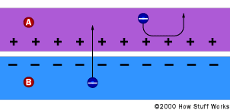
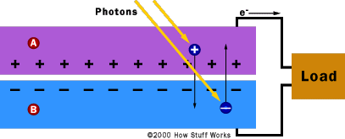
external current
built-in
E-Field
built-in
E-Field

Slide 37
p-n junction in PV Cell
The voltage–current characteristic for the p–n junction diode

Slide 38
Depletion region
Typically 1 m across the pn junction
Typically 1 V across the pn junction
E-field strength > 10,000 V/cm
Common, conventional p-n junction diode
This region is the “engine” of the PV Cell
  Source of the E-field and the electron-hole gatekeeper

Slide 39
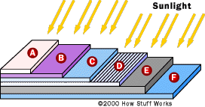
Responsible for collecting electrons
A: Cover glass (weather) D: n-type Si
B: Antireflective coating E: p-type Si
C: Contact grid F: Back contact
Basic structure of a generic silicon PV cell

Slide 40
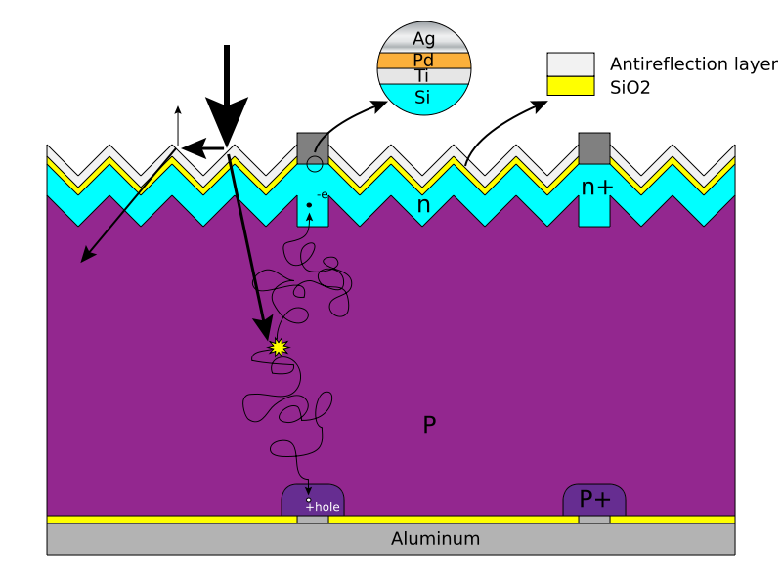
Basic structure of a silicon based solar cell and its working mechanism

Slide 41
Generic PV cell
Incoming Photons
Top Electrical Contacts
electrons →
- - - - Accumulated Negative Charges - - - -
n-type
built-in
E-Field
Holes
+ + + + + + + + +
Depletion Region
- - - - - - - - -
p-type
Electrons
+ + + Accumulated Positive Charges + + +
Bottom Electrical Contact
I →

Slide 42
Crystalline-silicon wafer-based solar cells: single p-n junction on a silicon wafer.
thin film solar cells: multiple junction, thin-film deposits of semiconductors (tandem-junction cell stacks two cells vertically, with each cell tuned for optimum conversion of different spectral segments).
Typically, the efficiencies of thin-film solar cells are lower compared with silicon (wafer-based) solar cells, but manufacturing costs are also lower, so that a lower cost per watt can be achieved. Another advantage of the reduced mass is that less support is needed when placing panels on rooftops and it allows fitting panels on light or flexible materials, even textiles.

Slide 43
Gallium arsenide (GaAs) multijunction
High-efficiency cells have been developed for special applications such as satellites and space exploration. These multijunction cells consist of multiple thin films produced using molecular beam epitaxy. A triple-junction cell, for example, may consist of the semiconductors: GaAs, Ge, and GaInP2.[15] Each type of semiconductor will have a characteristic band gap energy which, loosely speaking, causes it to absorb light most efficiently at a certain color, or more precisely, to absorb electromagnetic radiation over a portion of the spectrum. The semiconductors are carefully chosen to absorb nearly all of the solar spectrum, thus generating electricity from as much of the solar energy as possible

Slide 44
Gallium arsenide (GaAs) multijunction
GaAs multijunction devices are the most efficient solar cells to date, reaching a record high of 40.7% efficiency under solar concentration and laboratory conditions.[16] These devices use 20 to 30 different semiconductors layered in series. At the National Renewable Energy Laboratory, a new cell of area 0.26685 cm2 will generate a power of 2.6 W. They estimate that this technology could eventually produce electricity at a mere 8-10 cents/ kW/ hr. This is similar to the price of electricity today. Thus, this breakthrough could ultimately result in increased consumer use of solar cells.
This technology is still months away from commercial manufacture, but similar technology is being used right now on the Mars rover missions. Telectricity from as much of the solar energy as possible

Slide 45
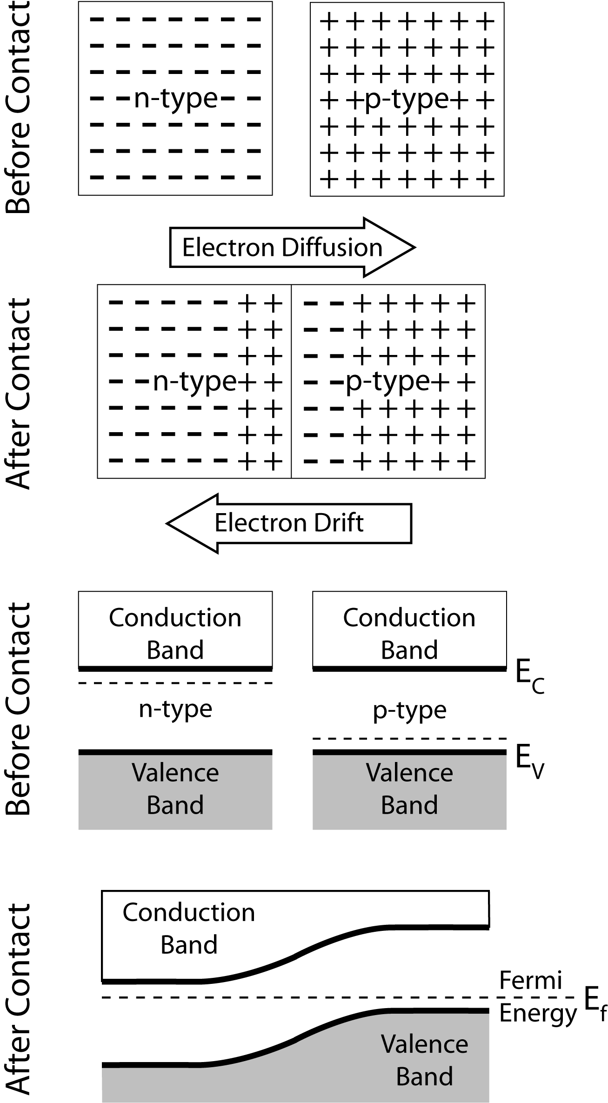
Review of Diodes
Two regions: “n-type” which donate electrons and “p-type” which accept electrons
p-n junction- diffusion of electrons and holes, current will flow readily in one direction (forward biased) but not in the other (reverse biased), this is the diode

Slide 46
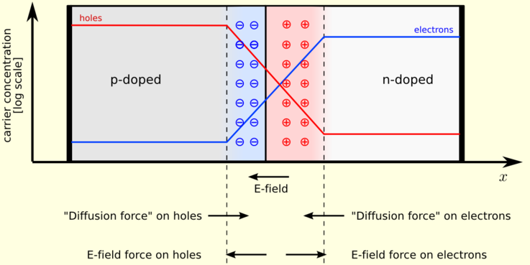
Review of Diodes
Making a connection from an n-type semiconductor (doped with impurities with extra electrons) to a p-type material (extra holes) induces an electric field
This field is what separates charges generated by light
The depletion width is the region where carriers have diffused
http://en.wikipedia.org/wiki/File:Pn-junction-equilibrium.png

Slide 47
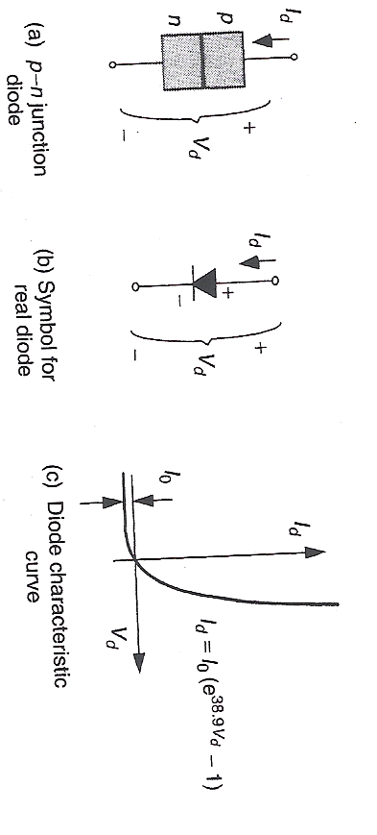
The p-n Junction Diode
Voltage-Current (VI) characteristics for a diode
Figure 8.15

Slide 48
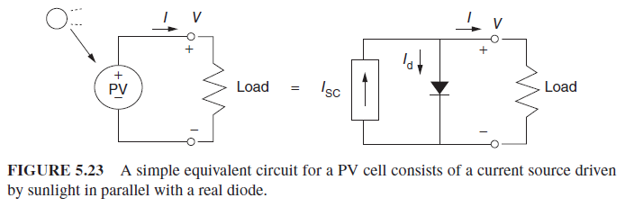
The Simplest Equivalent Circuit for a Photovoltaic Cell
A simple equivalent circuit model for a PV cell consists of a real diode in parallel with an ideal current source as shown below. The ideal current source delivers current in proportion to the solar flux to which it is exposed.

Slide 49
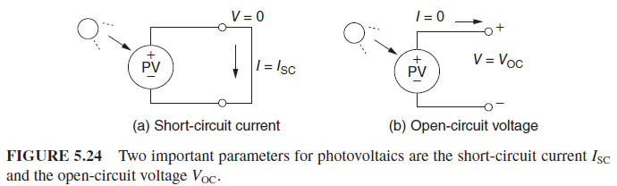

The Simplest Equivalent Circuit for a Photovoltaic Cell
The two important parameters of PV cell to be considered:
Short-circuit current, $I_{SC}$: the current that flows when the terminals are shorted together .
Open-circuit voltage, $V_{OC}$: the voltage across the terminals when the leads are left open.

Slide 50
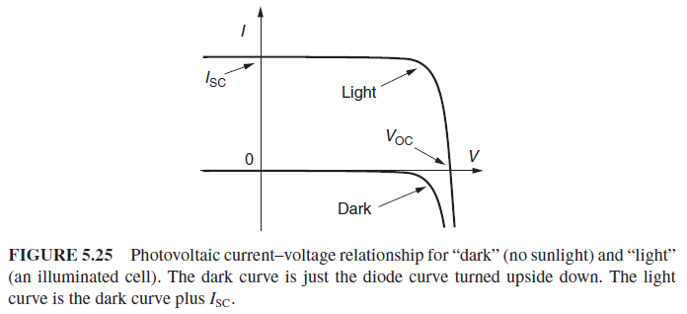

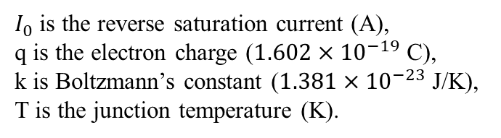
The Simplest Equivalent Circuit for a Photovoltaic Cell
When the leads of the equivalent circuit are shorted:
The current–voltage relationship for a PV cell when it is dark (no illumination) and light (illuminated) can be obtained with $I_{SC}$:
$$I=I_{SC}−I_{0}\left(e^{\frac{qV}{kT}}−1\right)$$
$I_{0}$ is the reverse saturation current (A),
q is the electron charge ($1.602×{10}^{−19}$ C),
k is Boltzmann’s constant ($1.381×{10}^{−23}$ J/K),
T is the junction temperature (K).

Slide 51

The Simplest Equivalent Circuit for a Photovoltaic Cell
When the leads from the PV cell are left open, the current in the circuit will be 0. By letting $I=0$ in the last equation, we can solve the open-circuit voltage $V_{OC}$:
$$V_{OC}=\frac{kT}{q}\ln\left(\frac{I_{SC}}{I_{0}}+1\right)$$

Slide 52
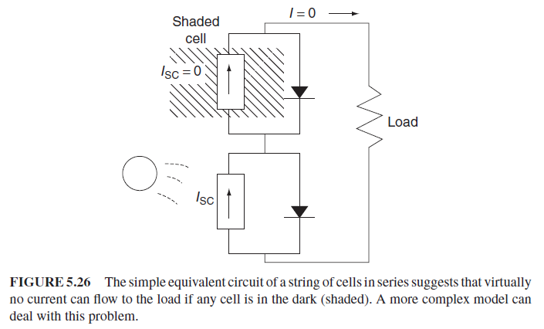
A More Accurate Equivalent Circuit for a PV Cell
A more complex PV equivalent circuit considering the impact of shading on a string of cells wired in series:

Slide 53
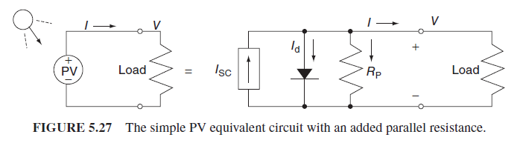

A More Accurate Equivalent Circuit for a PV Cell
PV equivalent circuit that includes some parallel leakage resistance $R_{P}$:
$$I=\left(I_{SC}−I_{d}\right)−\frac{V}{R_{p}}$$

Slide 54
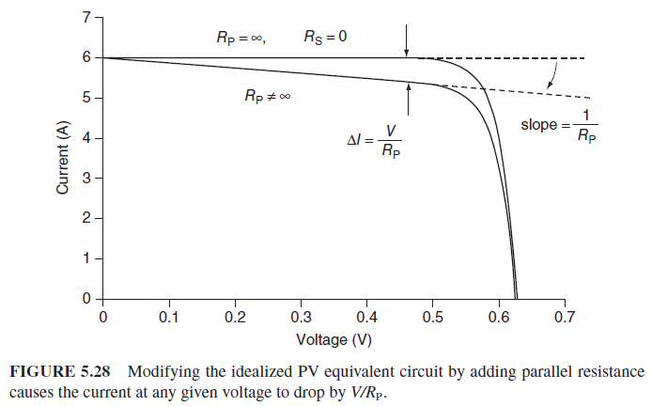
A More Accurate Equivalent Circuit for a PV Cell
The parallel leakage resistance causes load current for the ideal model to be decreased by V/RP as is shown below:

Slide 55
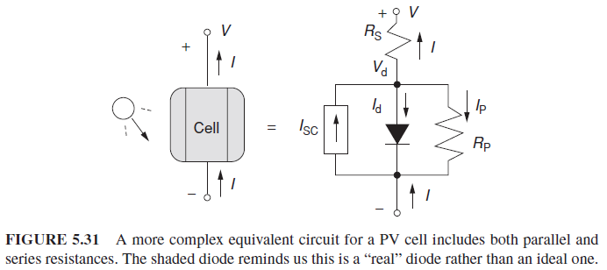

A More Accurate Equivalent Circuit for a PV Cell
An even better equivalent circuit will include series resistance as well as parallel resistance
$$I=I_{SC}−I_{0}\left\{\exp\left[\frac{q}{kT}\left(V+IR_{s}\right)\right]−1\right\}−\left(\frac{V+IR_{s}}{R_{p}}\right)$$

Slide 56
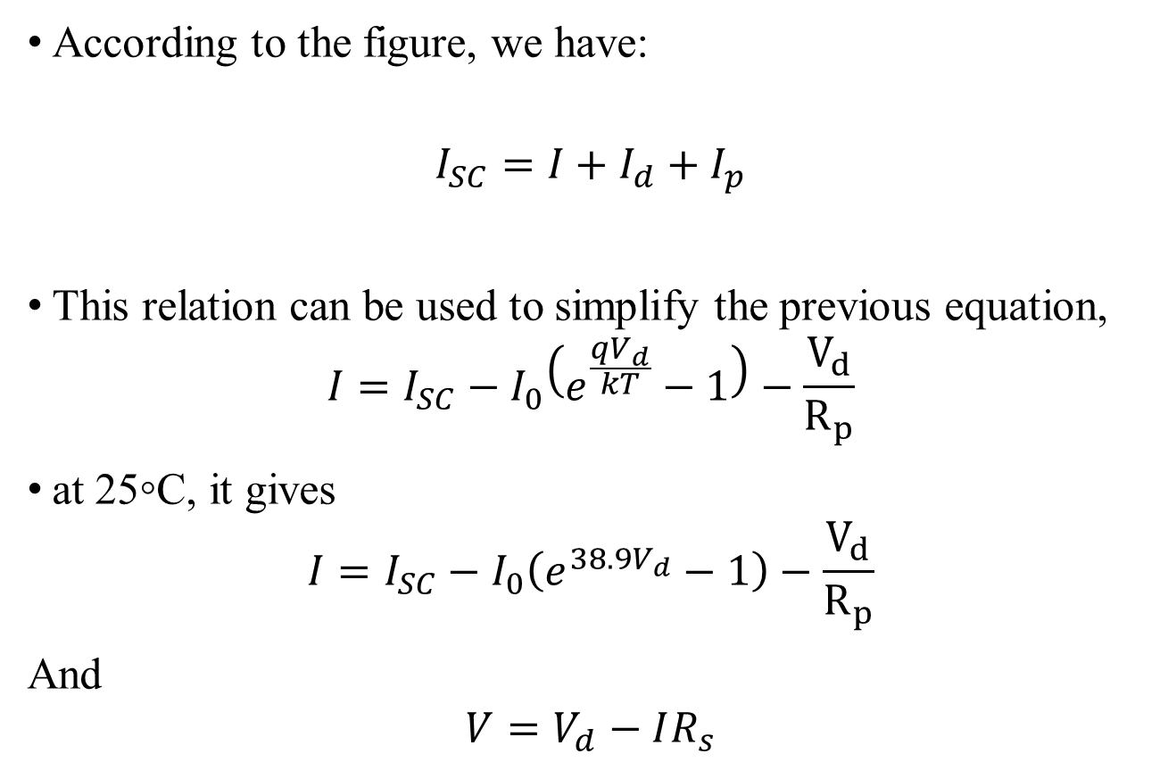
A More Accurate Equivalent Circuit for a PV Cell
According to the figure, we have:
$$I_{SC}=I+I_{d}+I_{p}$$
This relation can be used to simplify the previous equation,
$$I=I_{SC}−I_{0}\left(e^{\frac{qV_{d}}{kT}}−1\right)−\frac{V_{d}}{R_{p}}$$
at 25◦C, it gives
$$I=I_{SC}−I_{0}\left(e^{38.9V_{d}}−1\right)−\frac{V_{d}}{R_{p}}$$
And
$$V=V_{d}−IR_{s}$$

Slide 57
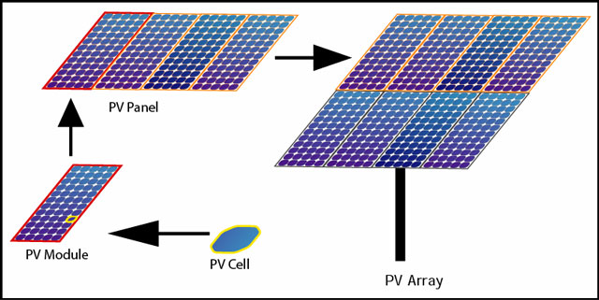
From cells to modules to arrays
Solar cells are also usually connected in series in modules, creating an additive voltage. Connecting cells in parallel will yield a higher current. Modules are then interconnected, in series or parallel, or both, to create an array with the desired peak DC voltage and current.

Slide 58
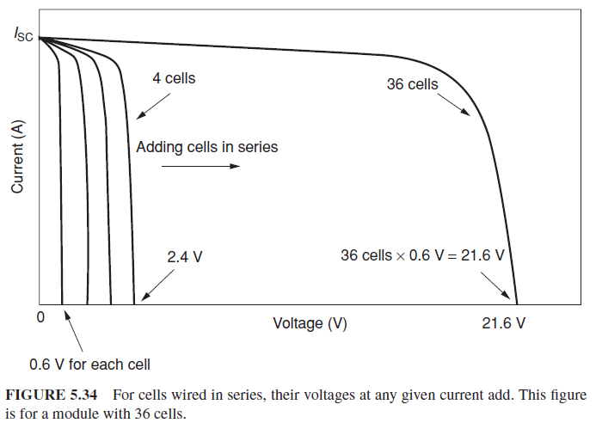

From Cells to a Module
When PVs are wired in series, all the cells carry the same current, and at any given current, their voltages add
$$V_{module}=n\left(V_{d}−IR_{s}\right)$$

Slide 59
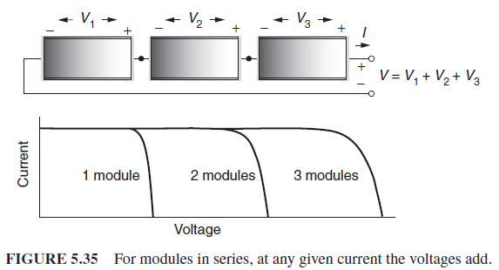
From Modules to Arrays
For a string of modules in series, the I–V curves are simply added along the voltage axis.

Slide 60
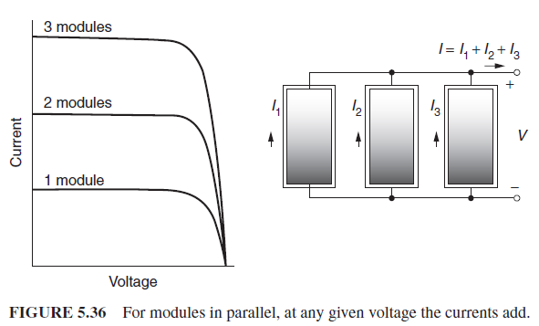
From Modules to Arrays
For modules in parallel, the same voltage is across each module and the total current is the sum of the currents.

Slide 61
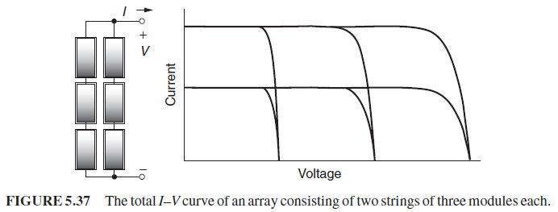
From Modules to Arrays
For modules consisting of parallel strings and series strings. The I-V curve of the array is shown as below:

Slide 62
The PV I-V curve under standard test conditions
Standard Test Conditions
1 sun (defined as)– 1000 watts/m² = 1kW/m²
25 ºC Cell Temp
AM 1.5 (Air Mass Ratio)
I-V curves
Key Statistics: V_{OC}, I_{SC}, Rated Power, V and I at Max Power

Slide 63
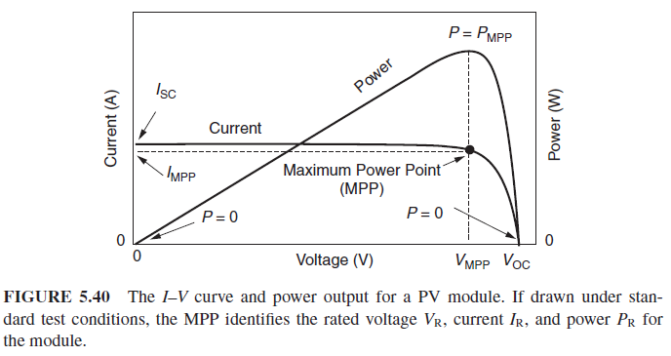
The PV I-V curve under standard test conditions
A generic I–V curve for a PV module:

Slide 64
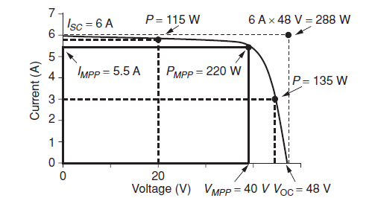

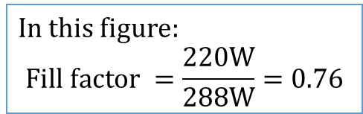
The PV I-V curve under standard test conditions
A quantity that is often used to characterize module performance is the fill factor (FF). The fill factor is the ratio of the power at the MPP to the product of $V_{OC}$ and $I_{SC}$.
$$Fill factor=\frac{power at the MPP}{V_{OC}⋅I_{SC}}=\frac{V_{MPP}⋅I_{MPP}}{V_{OC}⋅I_{SC}}$$
In this figure:
$$Fill factor =\frac{220W}{288W}=0.76$$

Slide 65
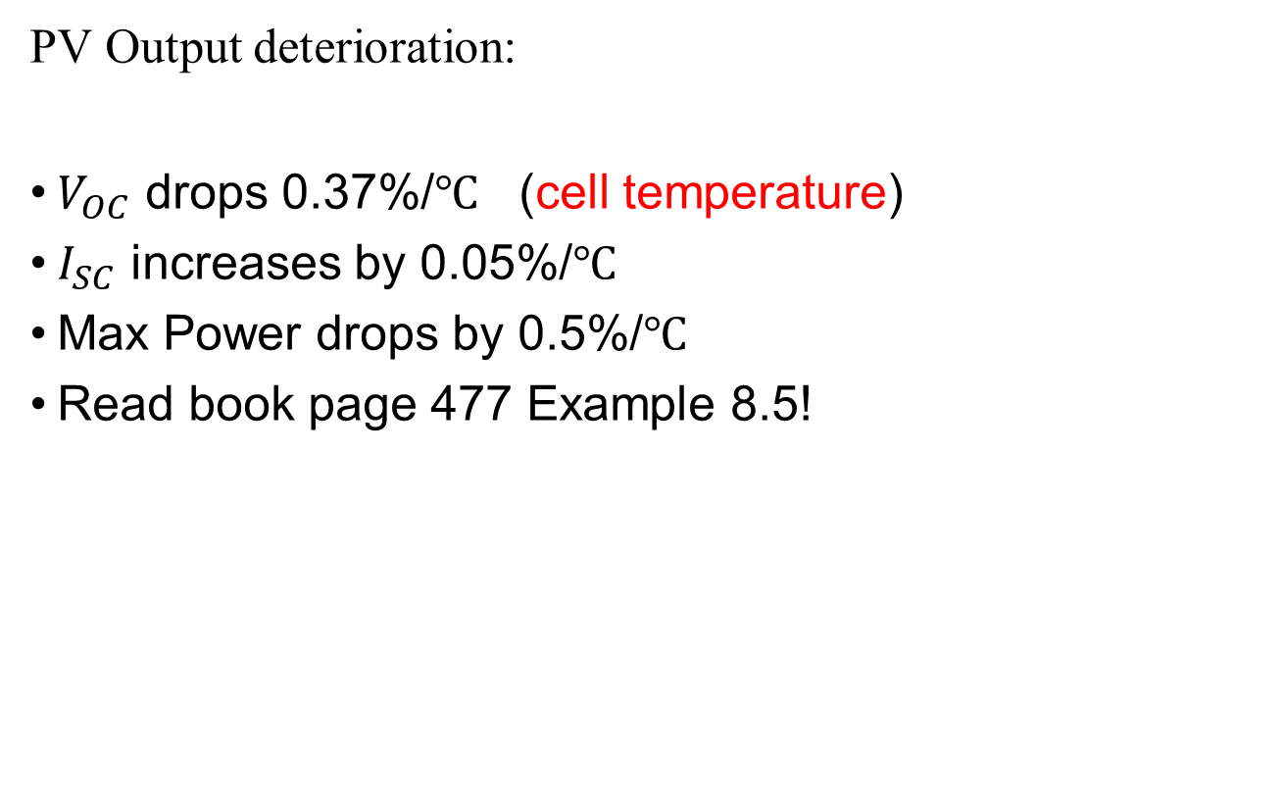
The PV I-V curve under standard test conditions
PV Output deterioration:
$V_{OC}$ drops 0.37%/$℃$ (cell temperature)
$I_{SC}$ increases by 0.05%/$℃$
Max Power drops by 0.5%/$℃$
Read book page 477 Example 8.5!

Slide 66
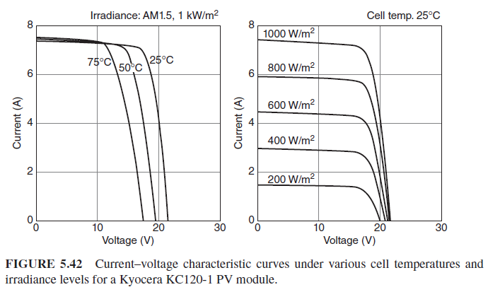

Impacts of temperature and insolation on I-V curves
Insolation drops: $I_{SC}$ drops in direct proportion. The entire I-V curve shifts downward which causes a modest reduction in $V_{OC}$ as well.
As PVs get hotter: $V_{OC}$ decreases by a considerable amount while the $I_{SC}$ increases only very slightly.

Slide 67







Impacts of temperature and insolation on I-V curves
Fahrenheit To Celsius Conversion: ___˚C = (5/9)( ___˚F - 32) OR ___˚F = (9/5)( ___˚C) +32
3
2.5
25$℃$
30$℃$
40$℃$
2
50$℃$
60$℃$
Amps
70$℃$
1.5
80$℃$
1
0.5
0
5
10
Volts
15
20
25

Slide 68
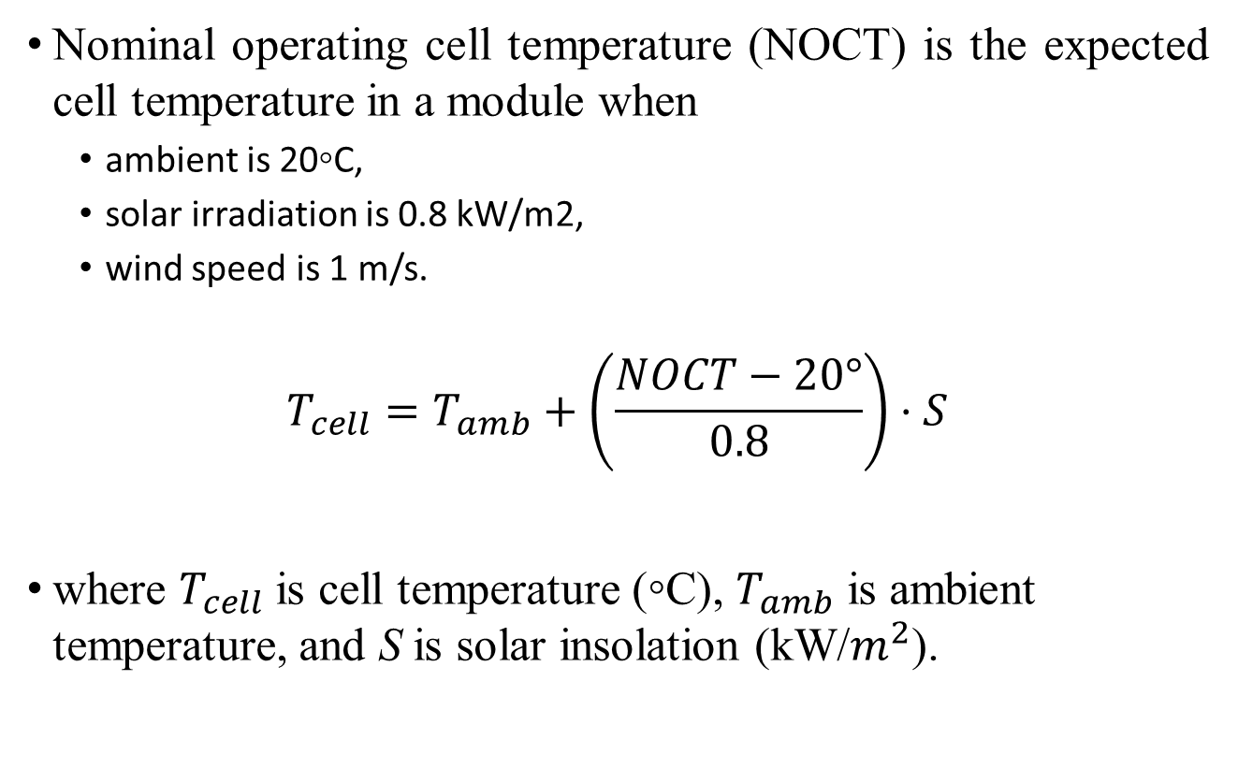
Impacts of temperature and insolation on I-V curves
Nominal operating cell temperature (NOCT) is the expected cell temperature in a module when
  ambient is 20◦C,
  solar irradiation is 0.8 kW/m2,
  wind speed is 1 m/s.
$$T_{cell}=T_{amb}+\left(\frac{NOCT−20°}{0.8}\right)⋅S$$
where $T_{cell}$ is cell temperature (◦C), $T_{amb}$ is ambient temperature, and S is solar insolation (kW/$m^{2}$).

Slide 69
Example 5.5 Impact of Cell Temperature on Power for a PV Module
Estimate (1) cell temperature, (2) open-circuit voltage, (3) maximum power output, and (4) fill factor for the Yingli module in Table 5.3 under conditions of 1-sun insolation and ambient temperature 30̊C.
TABLE 5.3 Example of PV Module Performance Data Under Standard Test Conditions (1 kW/m², AM1.5, 25C Cell Temperature)
Manufacture | SunPower | Yingli | First Solar | NanoSolar | Sharp
Model | E20/435 | YGR 245 | FS Series 3 | Utility 230 | NS-F135G5
Material | c-Si | mc-Si | CdTe | CIGS | a-Si
Panel efficiency | 20.10% | 15.60% | 12.20% | 11.60% | 9.60%
Rated power P_{MPP} (W_{p}) | 435 | 245 | 87.5 | 230 | 135
Rated voltage V_{MPP} (V) | 72.9 | 30.2 | 49.2 | 40.2 | 47
Rated current I_{MPP} (A) | 5.97 | 8.11 | 1.78 | 6 | 2.88
Open-circuit voltage V_{OC} (V) | 85.6 | 37.8 | 61 | 50.7 | 61.3
Short-circuit current I_{SC} (A) | 6.43 | 8.63 | 1.98 | 6.7 | 3.41
NOCT (C) | 45 | 46 | 45 | 47 | 45
Temp. Coeff. Of P_{max} (%K) | -0.38 | -0.45 | -0.25 | -0.39 | -0.24
Temp. Coeff. V_{OC} (%K) | -0.27 | -0.33 | -0.27 | -0.3 | -0.3
Temp. Coeff. I_{SC}(%K) | 0.05 | 0.06 | 0.04 | 0 | 0.07
Dimensions (m) | 2.07*1.05 | 1.65*0.99 | 1.2*0.6 | 1.93*1.03 | 1.4*1
Weight (kg) | 25.4 | 26.8 | 15 | 34.7 | 26

Slide 70
Example 5.5 Impact of Cell Temperature on Power for a PV Module
Using Equation 5.23 with S = 1 kW/m2 and NOCT = 46 ̊C from the table, cell temperature is estimated to be
From Table 5.3, for this module at the standard temperature of 25̊C, V_{OC} = 37.8 V. Since V_{OC} drops by 0.33%/̊C, the new V_{OC} will be about
With maximum power expected to drop about 0.45%/̊C, this 245-W module at its MPP will deliver
which is a rather significant drop of 17% from its rated power

Slide 71
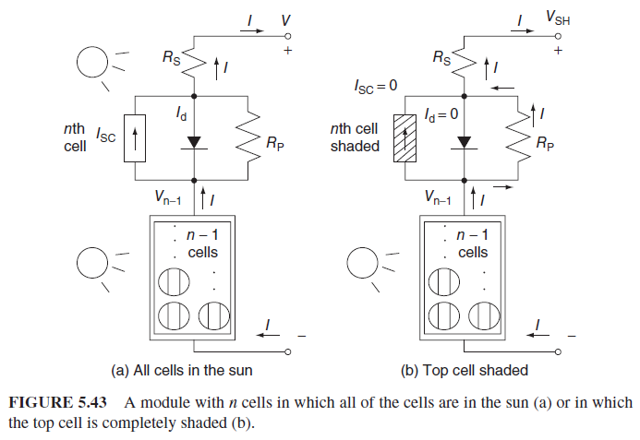

Shading impacts on I-V curves
When one cell is shaded as in figure (b), $I_{SC}$ becomes 0 and it causes the diode to be reverse biased. The entire current $I$ will go through $R_{p}$, thus the output voltage will be reduced.

Slide 72
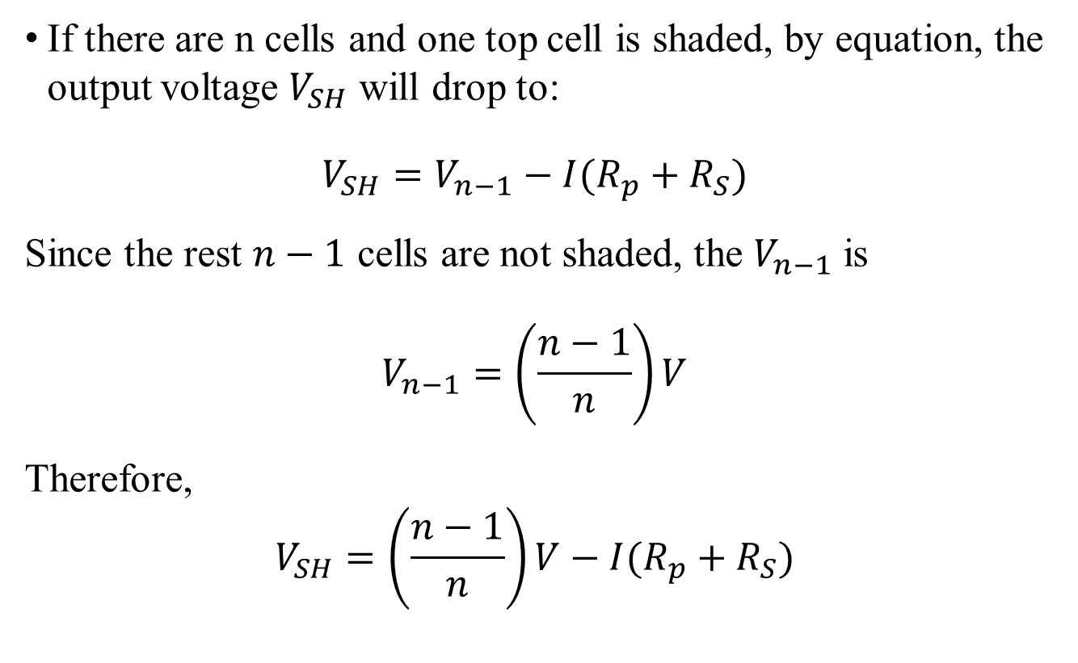
Shading impacts on I-V curves
If there are n cells and one top cell is shaded, by equation, the output voltage $V_{SH}$ will drop to:
$$V_{SH}=V_{n−1}−I(R_{p}+R_{S})$$
Since the rest $n−1$ cells are not shaded, the $V_{n−1}$ is
$$V_{n−1}=\left(\frac{n−1}{n}\right)V$$
Therefore,
$$V_{SH}=\left(\frac{n−1}{n}\right)V−I(R_{p}+R_{S})$$

Slide 73
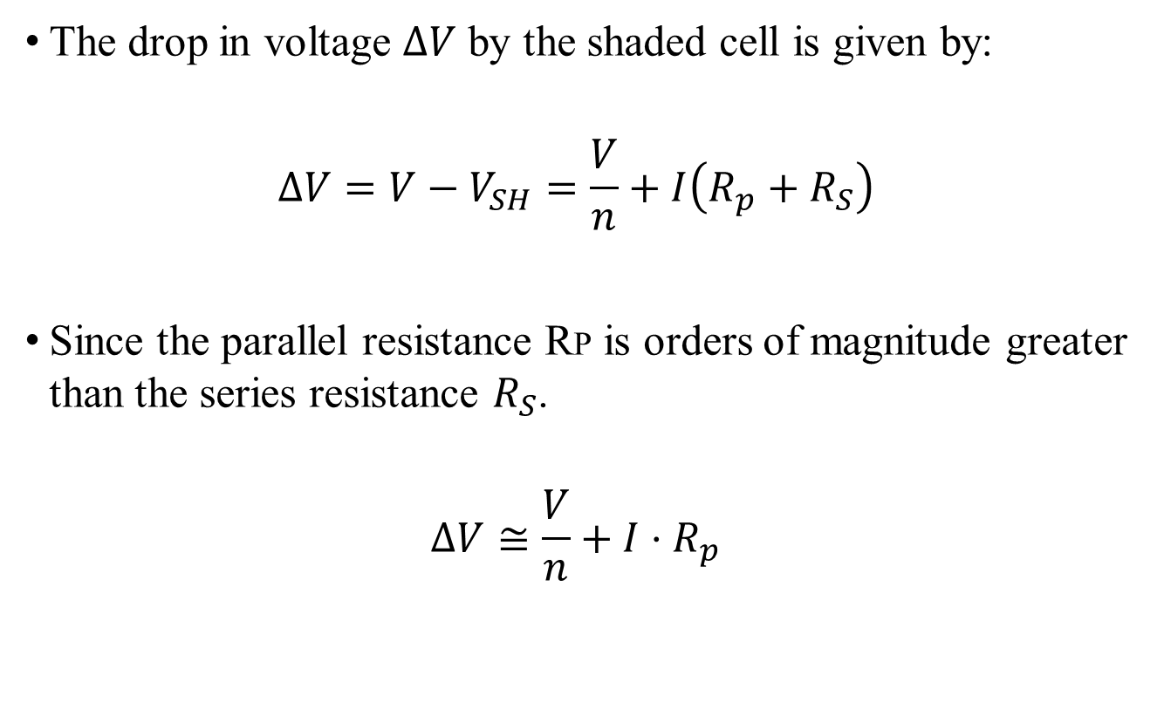
Shading impacts on I-V curves
The drop in voltage $ΔV$ by the shaded cell is given by:
$$ΔV=V−V_{SH}=\frac{V}{n}+I\left(R_{p}+R_{S}\right)$$
Since the parallel resistance RP is orders of magnitude greater than the series resistance $R_{S}$.
$$ΔV≅\frac{V}{n}+I⋅R_{p}$$

Slide 74
In-class problem 2
Based on Problem 1, Rp=6.6 ohm. In full sun and at current I=2.14 A the output voltage was found to be V=19.41 V (no shading condition). If one cell is shaded and this current somehow stays the same, then:
1. What would be the new module output voltage and power?
2. What would be the voltage drop across the shaded cell?
3. How much power would be dissipated in the shaded cell?
4. Repeat if 2 cells are shaded

Slide 75
1. The voltage drop in module voltage is
The new output voltage will be 19.41 – 14.66 = 4.75 v
Power delivered by the module with one cell shaded would be
For comparison, in full sun the module was producing 2.14 ^{A} ×19.41 ^{V} = 41.5 w
2. Voltage drop across the shaded cell is
3. The power dissipated in the shaded cell is

Slide 76
In class exercise
Impacts of Shading on a PV Module. The 72-cell PV module had a parallel resistance per cell of RP =10.0 ohms and a series resistance RS of 0.001 ohms. In full sun and at current I = 5.73 A, the output voltage of the module was found to be V = 40.63 V. If one cell is shaded, find the following if somehow the same 5.73 A is forced toflow through the module.
a. The module output voltage.
b. Power dissipated in the shaded cell

Slide 77
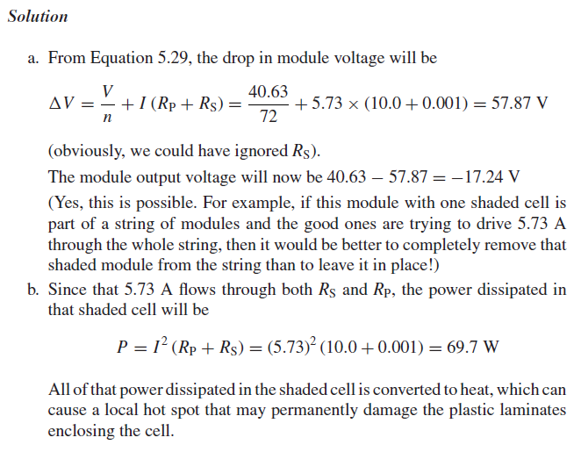
In class exercise

Slide 78
The Impact of the Bypass Diodes for Shade Mitigation on the I-V Curve
Impact of bypass diodes. Drawn for five modules in series delivering 65 V to a battery bank. With one module having two shaded cells, charging current drops by almost one-third when there are no bypass diodes. With the module bypass diodes there is very little drop.

Slide 79
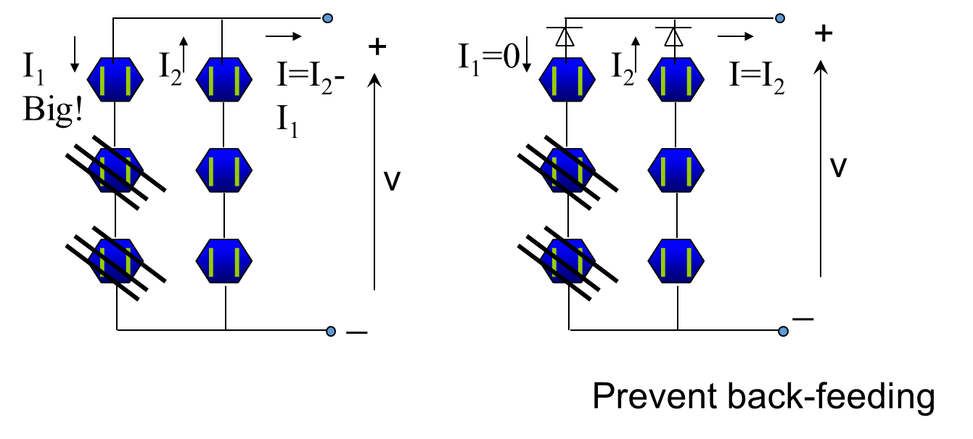
Blocking Diodes Mitigation (Parallel cells)

Slide 80

Bypass Diodes and Blocking Diodes for Shade Mitigation
V=0.5v
V=-0.6v
I
Bypass diode Mitigation
I
One cell in sun
clamp
0v
0v
I
$$V_{SH}=−(R_{p}+R_{S})I$$
Note: in real life, it is difficult to put diode for every cell!
Usually we put a diode for each module instead. This helps for case in which many modules are connected in series.
One cell shaded

Slide 81
Bypass Diodes for Shade Mitigation
Mitigating the shade problem with a bypass diode. In the sun (a), the bypass diode is cut off and all the normal current goes through the solar cell. In shade (b), the bypass diode conducts current around the shaded cell, allowing just the diode drop of about 0.6 V to occur.

Slide 82
Bypass Diodes for Shade Mitigation
The ability of bypass diodes to mitigate shading when modules are charging a 65 V battery. Without bypass diodes, a partially shaded module constricts the current delivered to the load (b). With bypass diodes, current is diverted around the shaded module. (one cell shaded)

Slide 83
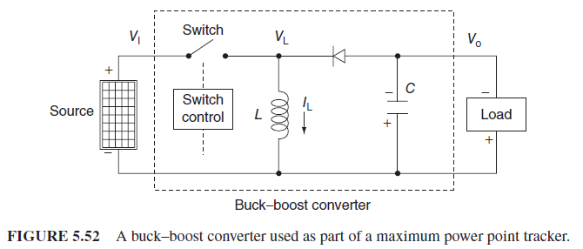
Maximum power point trackers
The Buck–Boost Converter:
  A boost converter is a commonly used circuit to step up DC voltage.
  A buck converter is often used to step down voltage.
  A buck–boost converter is capable of raising or lowering a DC voltage from its source to whatever DC voltage is needed by the load

Slide 84
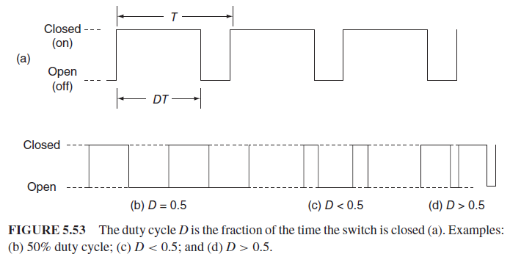
Maximum power point trackers
The Buck–Boost Converter:
The buck-boost converter is controlled with pulse–width modulation (PWM) signal:

Slide 85
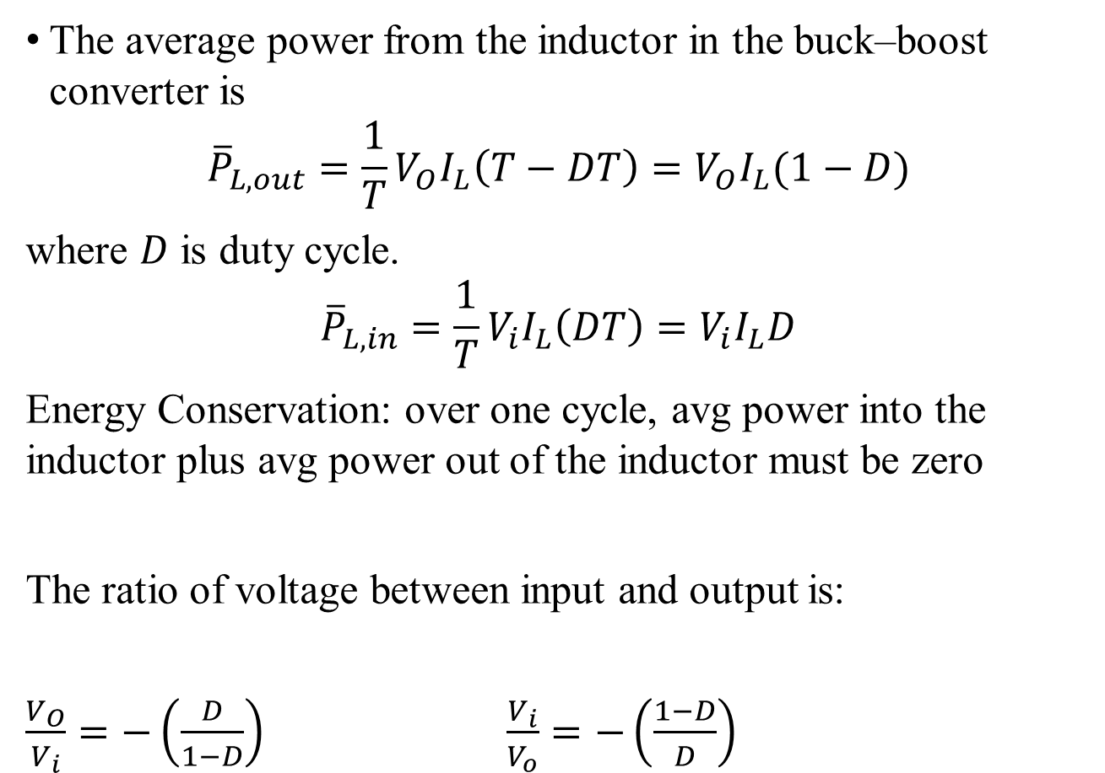
Maximum power point trackers
The average power from the inductor in the buck–boost converter is
$${\overline{P}}_{L,out}=\frac{1}{T}V_{O}I_{L}\left(T−DT\right)=V_{O}I_{L}(1−D)$$
where $D$ is duty cycle.
$${\overline{P}}_{L,in}=\frac{1}{T}V_{i}I_{L}\left(DT\right)=V_{i}I_{L}D$$
Energy Conservation: over one cycle, avg power into the inductor plus avg power out of the inductor must be zero
The ratio of voltage between input and output is:
$\frac{V_{O}}{V_{i}}=−\left(\frac{D}{1−D}\right)$ $\frac{V_{i}}{V_{o}}=−\left(\frac{1−D}{D}\right)$

Slide 86

MPPT Controllers
MPPT is a method to adjust the duty cycle of its DC-to-DC converter to keep the PV array voltage on its MPP.
The controller senses the current and voltage being delivered by the PVs and, using any of a number of possible control approaches, adjusts the converter to best match the desired output to the load.

Slide 87

MPPT Controllers
Hill-climbing or perturb-and-observe approaches:
  This method adjusts the PV output voltage and see whether the change made increases or decreases the power delivered.

Slide 88

MPPT Controllers

Slide 89



MPPT Controllers
Incremental conductance:
  based on the fact that the slope of the power versus voltage curve is zero at the MPP.
$$At the MPP: \frac{dP}{dV}=0$$
Since $P=IV$, then
$$\frac{dP}{dV}=I\frac{dV}{dV}+V\frac{dI}{dV}=I+V\frac{dI}{dV}≈I+V\frac{ΔI}{ΔV}$$
Then, the MPP is reached when:
$$\frac{ΔI}{ΔV}=−\frac{I}{V}$$

Slide 90

MPPT Controllers
Incremental conductance:
The procedure of the incremental conductance algorithm to adjust the duty cycle of a DC-to-DC converter to reach MPP.

Slide 91
References
http://en.wikipedia.org/wiki/Conduction_band
http://en.wikipedia.org/wiki/Solar_cells
http://www.q-cells.com/cmadmin_2_499_0.html
http://science.howstuffworks.com/solar-cell.htm
Dr. Tom Overbye’s slides

